Slide 1
Olympics Analysis
CS 176
Srushti Vaidyanathan
Brooklynn Fugate
Paige Burke

Slide 2
Data Sets
Olympic Athletes
Biometrics of all the Olympic athletes who have competed since 1896. This includes name, sex of athlete, height, weight, age, first time competing, nation of origin, and the country they represent.
Summer Olympic Games
Data related to the Summer Olympics including athlete’s name, year of Games, the Games they have participated in, host city, sport, event, and what medal was earned.
Winter Olympic Games
Data related to the Winter Olympic Games including athlete’s name, year of Games, the Games they have participated in, host city, sport, event, and what medal was earned.

Slide 3
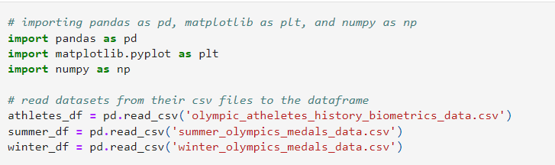
Set Up
Imported pandas, matplotlib, and numpy
Read csv files and created a dataframe for each dataset

Slide 4
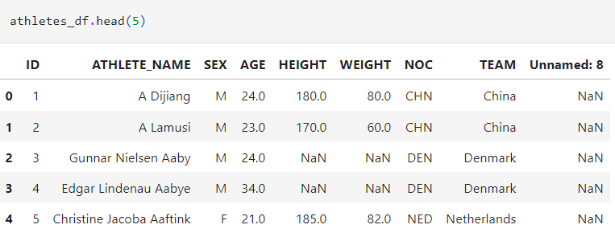
Example output for athletes_df
Example output of the first 5 rows of athletes_df

Slide 5
Cleaning
Standardized all dataframes to date time format
Dropped duplicate values from dataframes, keeping only the first value
Deleted empty columns from csv files

Slide 6
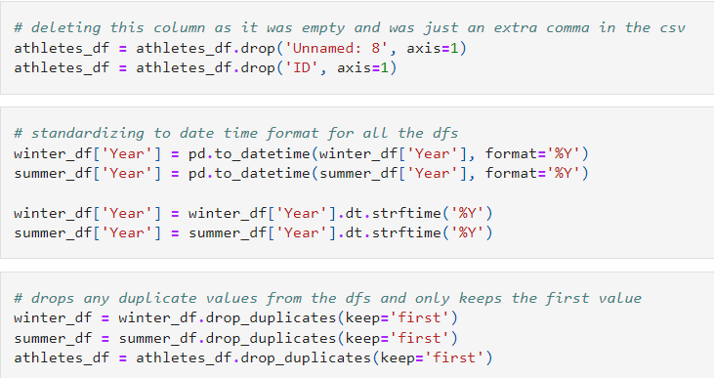

Slide 7
Filtering
Created a dataframe for male athletes and a dataframe for female athletes to analyze difference between men’s and women’s performance. The dataframe is subsetted using the ‘Sex’ column.
Created a dataframe of athletes who have won a medal. This was done by isolating the athletes that have a non-NA value in the ‘Medal’ column.
Created a new dataframe which is a subset of winners_df with only the ‘NOC’ and ‘Medal’ columns. Then grouped by ‘NOC’ to see which country won the most/least number of medals.

Slide 8
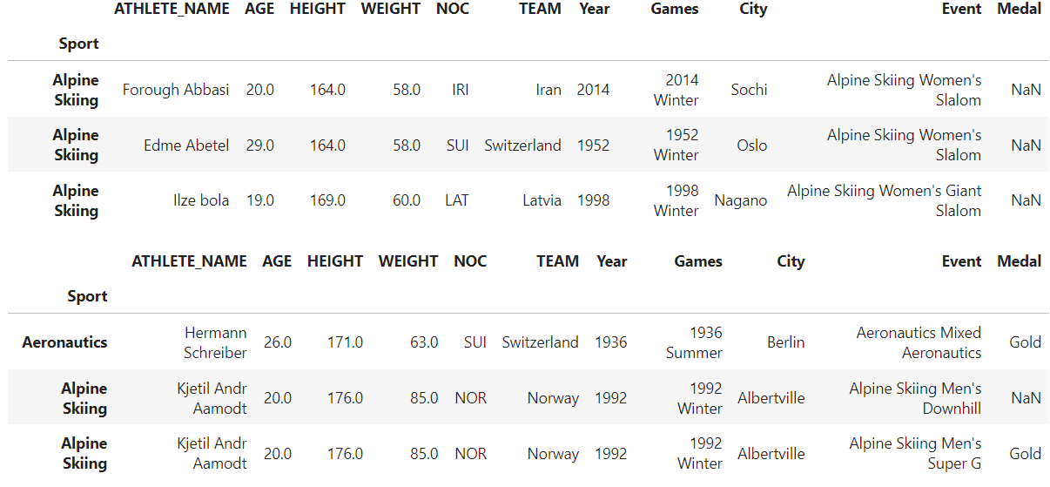
Female and Male DFs

Slide 9
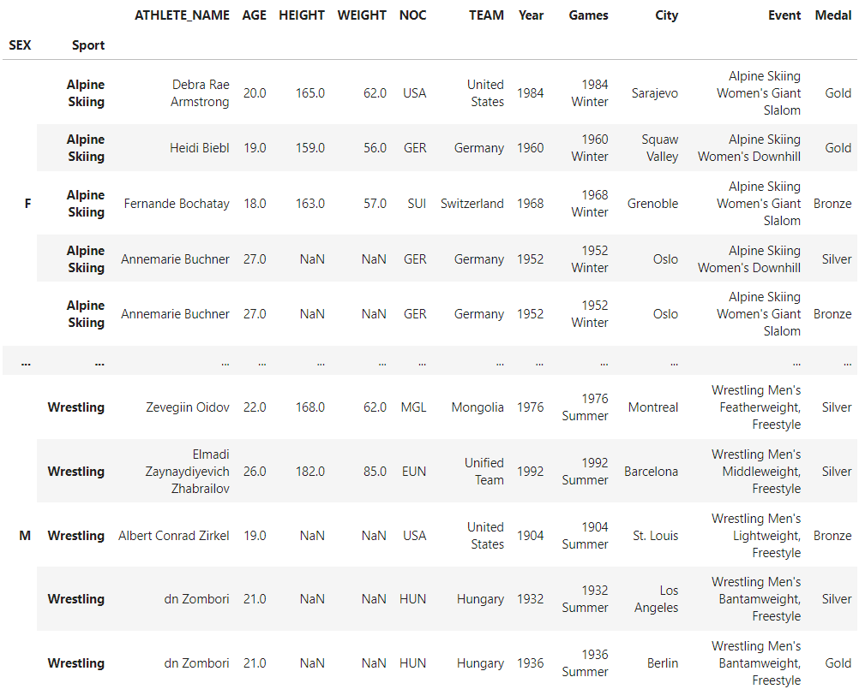
Example output consisting of filtered winners

Slide 10
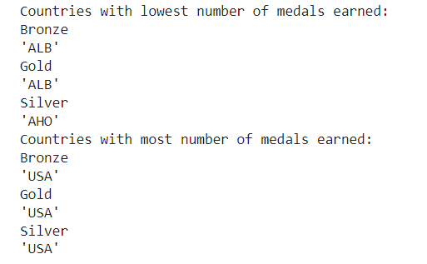
Medal Counts by Country Example

Slide 11
Sorting
Sorted by age of athletes to analyze the performance of the youngest and oldest athletes.
This was done for all athletes, just male athletes, and just female athletes.
Total Age Range: 10-97
Female Age Range: 11-74
Male Age Range: 10-97
All of the oldest athletes were ‘Art Competitions’ so we filtered them out
Female Age Range: 11-63
Male Age Range: 10-71
Still an 8 year gap between oldest male and female

Slide 12
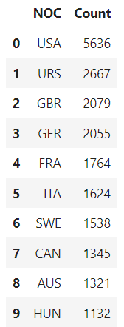
Sorting
Using the groupby function, grouped by the ‘NOC’, then got the size of each of the sub dataframes to get the counts of how many medals each of the countries won.
Then sorted by medal counts to see how many medals the top 10 medal earning countries won.
Found that the USA has twice as many medals as the second place winner (the distribution there on is pretty linear decline)

Slide 13
Merging
Merged the winter and summer dataframes using inner based on ‘Name’ to see the athletes who have competed in both the winter and summer games.
This data was filtered so the games were within 20 years of each other due to athletes having the same names.
275 unique athletes have competed in both the Summer and Winter Games.

Slide 14
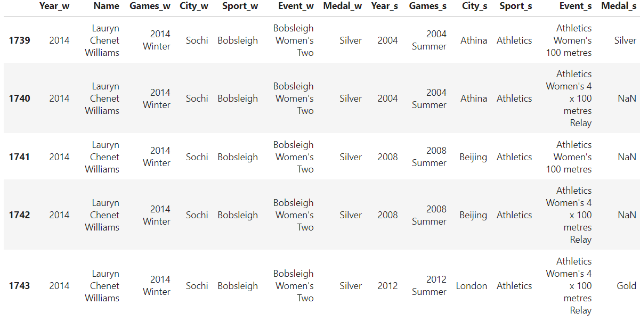
Overlapping Athletes

Slide 15
Merging
Merged the winter and summer dataframes using outer to have all the rows of both datasets. The dataframe contains data of all instances of an athlete’s performance in the Olympics.
The dataframes were combined on the common columns: Year, Name, Games, City, Event, Medal

Slide 16
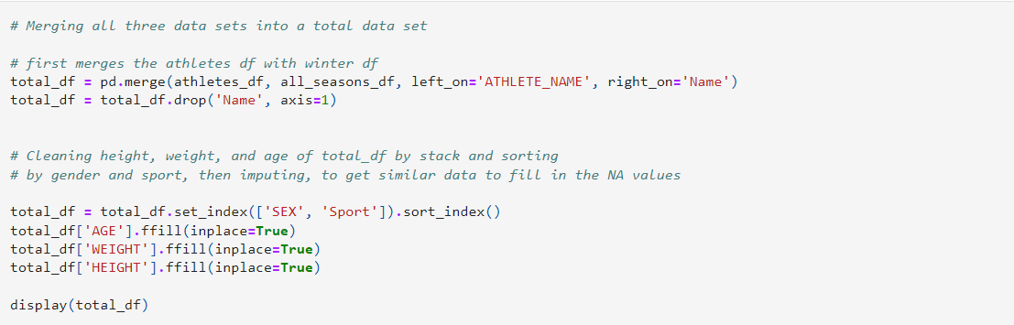
Merging
Merged all three datasets into a total dataset. Merges the athletes dataframe and the all seasons dataframe based on athlete name.
Used this to fill NA values for AGE, HEIGHT, and WEIGHT, by sorting by sport and gender to forward fill similar data into the empty positions

Slide 17
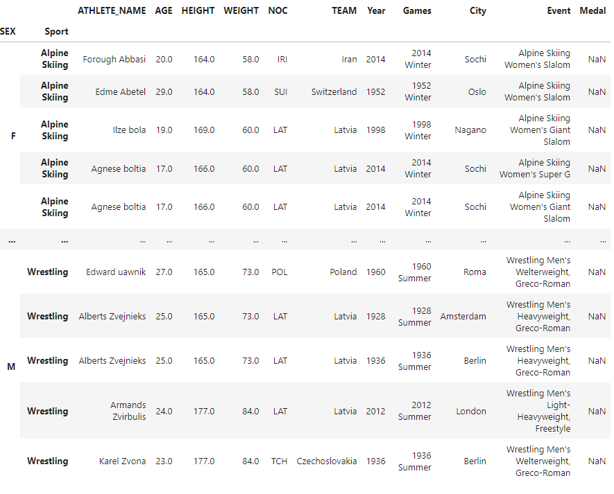
All Three Dataframes combined

Slide 18
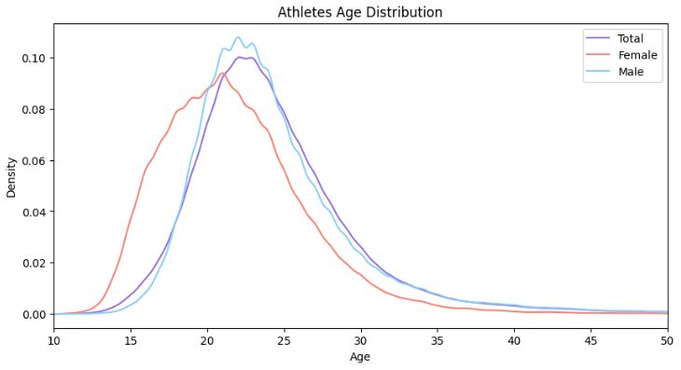
Visualizations
Studying the age distribution for all athletes, males, and females
Most athletes are between the ages of about 15 and 35
Females seem to peak earlier than males
Total distribution matches closer to males, suggesting more male athletes

Slide 19
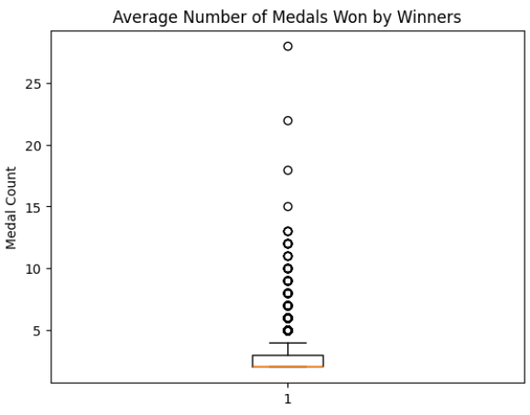
Visualizations
Represents the distribution of number of times an athlete places on the podium
Filtered to only have athletes win more than 1 win
Min: 2, Median: 2, Max: 28, Avg: 2.65
The outlier at 28 medals was Michael Phelps, who set a world record for most medals won

Slide 20
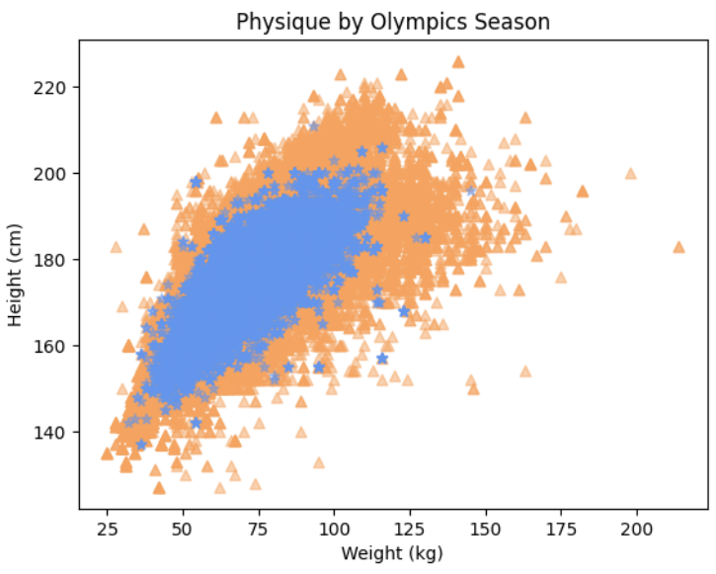
Visualizations
Analyze the differences in physiques of summer vs winter athletes (weight vs height)
Winter athletes seem smaller and lighter
71 kg difference between max weights
Main difference is that there are significantly more summer athletes than winter
Relationship between height and weight is linear

Slide 21
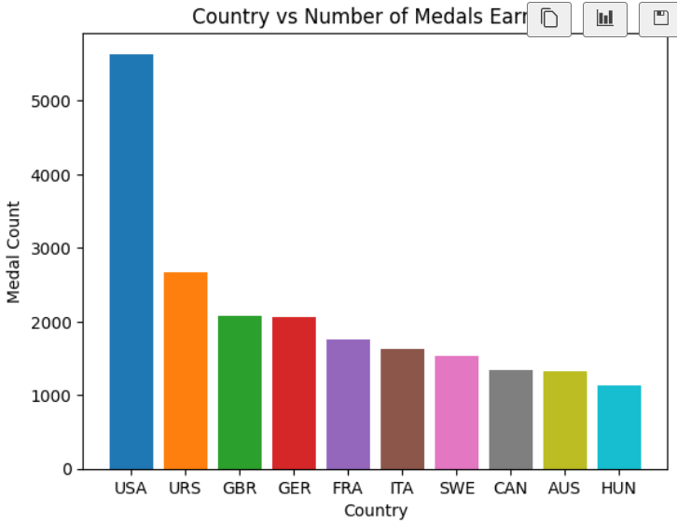
Visualizations
Distribution of the top 10 highest medal earning countries
Main purpose was to actually be able to see the difference in medal counts between the US and the remaining countries
The remainder of the countries seem to have a more reasonable linear relationship

Slide 22
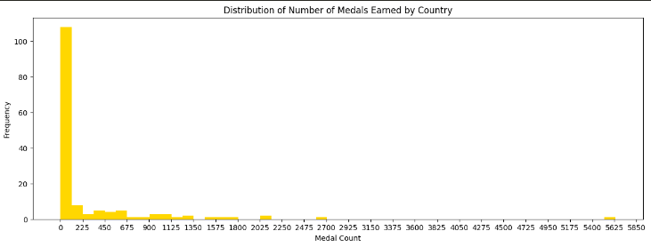
Visualizations
Histogram of the distribution of number of wins by country
Over 100 countries earned less than 113 medals,
Around 8-10 earned between 113-225
Sparser as the medal counts increase

Slide 23
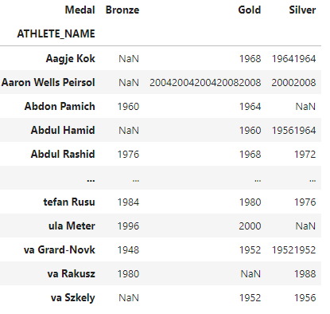
Pivoting
Intent is to measure change in athletes’ performance over the years
Display the years in which an athlete won each medal
Use to compare Medal columns by the year in these columns (ex. an athlete won Gold in 1952 and then Silver in 1956 we can see that they had a decline in their performance)

Slide 24
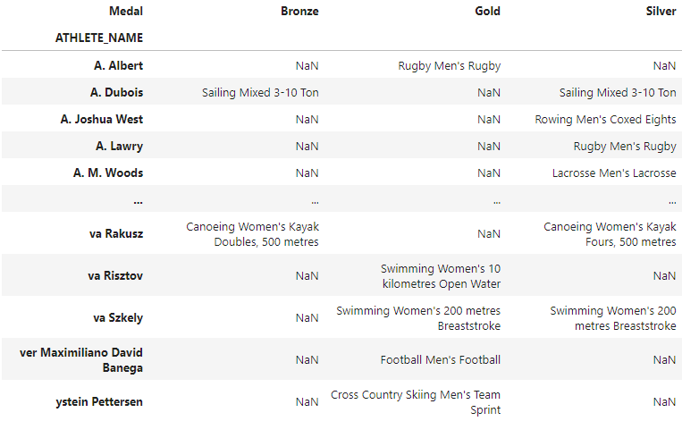
Pivoting
Similar to the previous pivot but we can see what event they won in

Slide 25
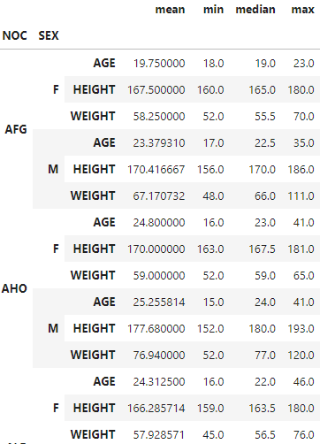
Pivoting
Allows for the comparison of athletes’ biometrics by sex and NOC
We applied the mean, min, median, and max functions to get various aspect of each biometric
Can be used to analyze the differences in biometrics between countries and the influence of gender
Ex. We can see that on average females from Afghanistan are 4 years younger than males

